Slide 1
Public Key Cryptography | RSA Algorithm Example
How to solve RSA Algorithm Problems??
(RSA algorithm is an asymmetric cryptography algorithm which means, there should be two keys involve while communicating, i.e., public key and private key.)

Slide 2
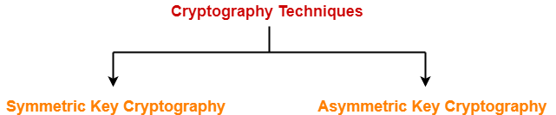
We have discussed-
Cryptography is a method of storing and transmitting data in a particular form.
Cryptography techniques are-

Slide 3
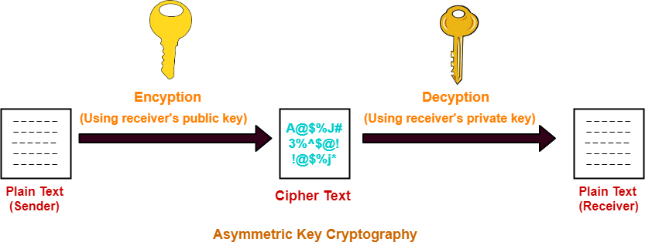
Asymmetric Key Cryptography-
In this technique,
Sender and receiver use different keys to encrypt and decrypt the message.
It is called so because sender and receiver use different keys.
It is also called as public key cryptography.
Working-
The message exchange using public key cryptography involves the following steps-

Slide 4
Step-01:
At sender side,
Sender encrypts the message using receiver’s public key.
The public key of receiver is publicly available and known to everyone.
Encryption converts the message into a cipher text.
This cipher text can be decrypted only using the receiver’s private key.
Step-02:
The cipher text is sent to the receiver over the communication channel.
Step-03:
At receiver side,
Receiver decrypts the cipher text using his private key.
The private key of the receiver is known only to the receiver.
Using the public key, it is not possible for anyone to determine the receiver’s private key.
After decryption, cipher text converts back into a readable format.

Slide 5
Advantages-
The advantages of public key cryptography are-
It is more robust.
It is less susceptible to third-party security breach attempts.
Disadvantages-
The disadvantages of public key cryptography are-
It involves high computational requirements.
It is slower than symmetric key cryptography.

Slide 6
RSA Algorithm-
Let-
Public key of the receiver = (e , n)
Private key of the receiver = (d , n)
Then, RSA Algorithm works in the following steps-
Step-01:
At sender side,
Sender represents the message to be sent as an integer between 0 and n-1.
Sender encrypts the message using the public key of receiver.
It raises the plain text message ‘P’ to the e^{th} power modulo n.
This converts the message into cipher text ‘C’.
C = P^{e} mod n or C = Me mod n

Slide 7
Step-02:
The cipher text ‘C’ is sent to the receiver over the communication channel.
Step-03:
At receiver side,
Receiver decrypts the cipher text using his private key.
It raises the cipher text ‘C’ to the d^{th} power modulo n.
This converts the cipher text back into the plain text ‘P’.
P = C^{d} mod n

Slide 8
KEY GENERATION
(Steps to Generate Public Key And Private Key)
An individual can generate his public key and private key using the following steps-
Step-01:
Choose any two prime numbers p and q such that-
They are different.
They are very large.
Step-02:
Calculate ‘n’ and toilent function Ø(n) where-
n = p x q
Ø(n) = (p-1) x (q-1)

Slide 9
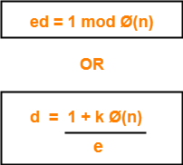
Step-03:
Choose any value of ‘e’ such that-
1 < e < Ø(n)
gcd (e, Ø(n)) = 1
Step-04:
Determine ‘d’ such that-
ed mod Ø(n)=1
NOTE:
You already know the value of ‘e’ and Ø(n).
Choose the least positive integer value of ‘k’ which gives the integer value of ‘d’ as a result.
Use trial and error method.
Start substituting different values of ‘k’ from 0.

Slide 10
PUBLIC KEY={e,n}
PRIVATE KEY={d,n}
2. Encryption
C = Me mod n
3. Decryption
P = C^{d} mod n
PRACTICE PROBLEMS BASED ON RSA ALGORITHM-

Slide 11
In a RSA cryptosystem, a participant A uses two prime numbers p = 13 and q = 17 to generate her public and private keys. If the public key of A is 35, then the private key of A is _______.
Given-
Prime numbers p = 13 and q = 17
Public key i.e e= 35

Slide 12
Step-01:
Calculate ‘n’ and toilent function Ø(n).
Value of n,
n = p x q
n = 13 x 17
∴ n = 221
Toilent function,
Ø(n) = (p-1) x (q-1)
Ø(n) = (13-1) x (17-1)
∴ Ø(n) = 192
Step-02:
We are already given the value of e = 35.
Thus, public key = (e , n) = (35 , 221)

Slide 13
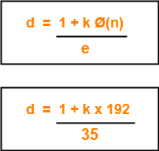
Step-03:
Determine ‘d’ such that-
Here,
The least value of ‘k’ which gives the integer value of ‘d’ is k = 2.
On substituting k = 2, we get d = 11.
Thus, private key of participant A = (d , n) = (11, 221).

Slide 14
TASK:
Q1 P=3 ,q=5, e=7
Q2 P=7q=11 Find public key and private key
Q3 Alice selects 2 prime numbers: P=5 q=11 , Alice selects her public exponent e = 3 Compute d , the private exponent of Alice

Slide 15
Summary:
• RSA is a public key or asymmetric key algorithm.
• RSA stands for Rivest, Shamir and Adleman the three inventors of RSA algorithm.
• Each user has to generate two keys public key known to all and private key only known to him.
• Encryption is done using the public key of the intended receiver.
• A receiver cracks the message using its private key.
• Encrypting the message using receivers public key assures confidentially of the message as no third party would be able to crack the message because the message can only be decrypted by using receivers private key which is only known to him.
Using the double public key scheme, we can also achieve authenticity

